Slide 1
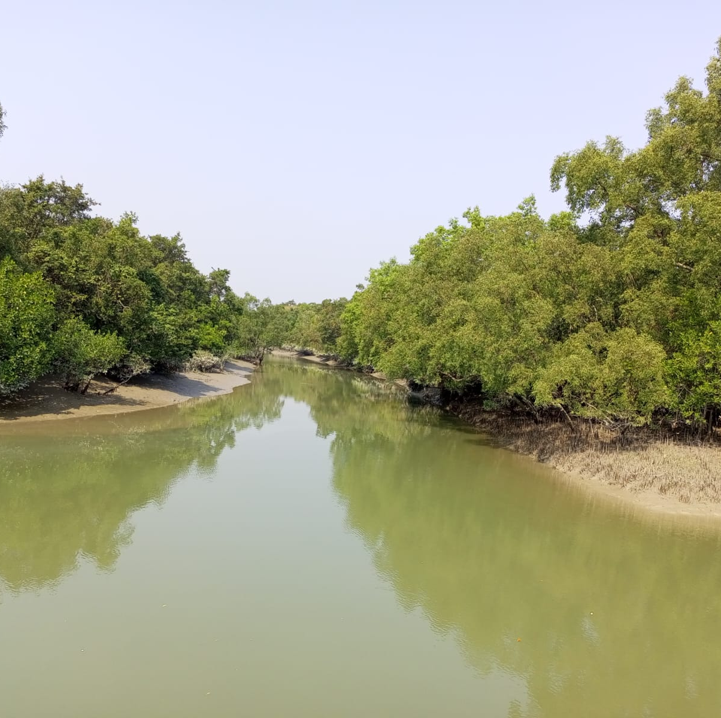
Mangrove & Sundarban
Sambita Mallick

Slide 2
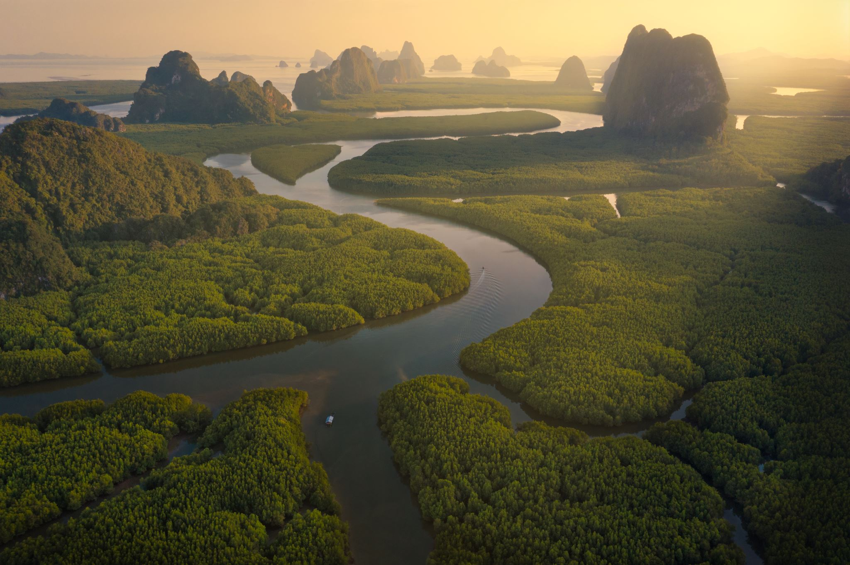
What is mangrove forest?
salt-tolerant tree or shrub
grows in brackish water, inundated soils and intertidal areas
found in tropical and subtropical regions in the world

Slide 3
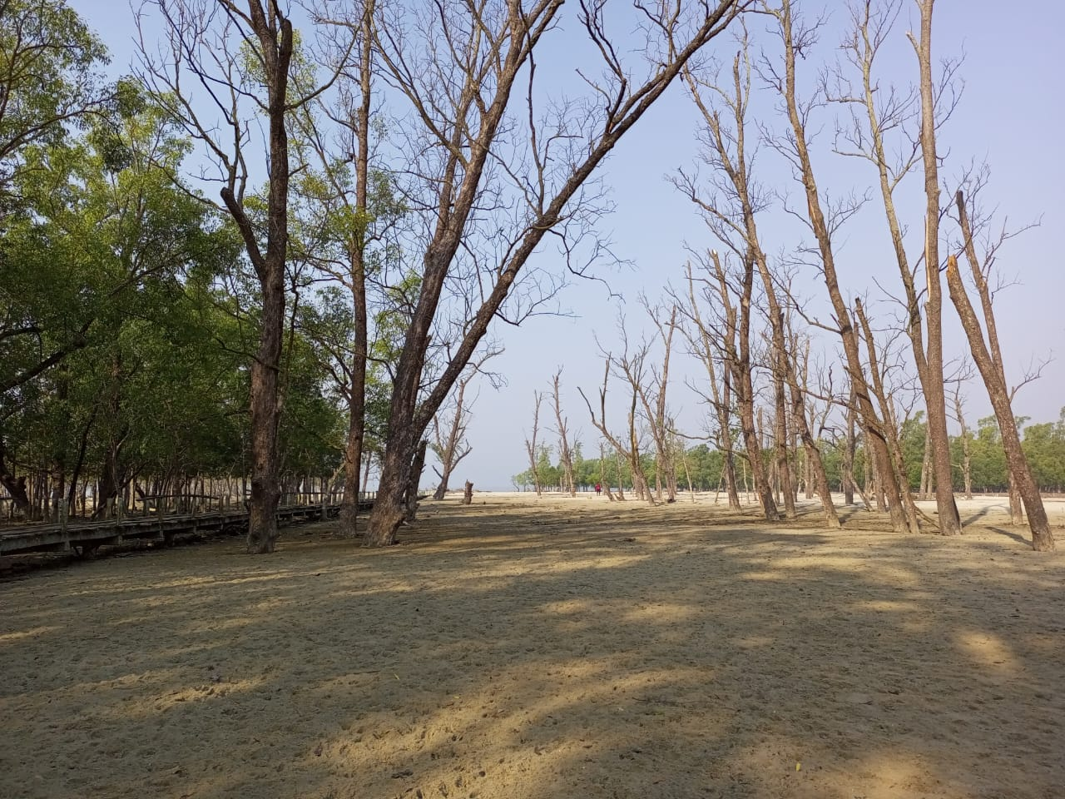
3 types of Flora and Fauna
Terrestrial fauna and flora
Areial flora and fauna
Aquatic flora and fauna

Slide 4
Mangrove

Slide 5
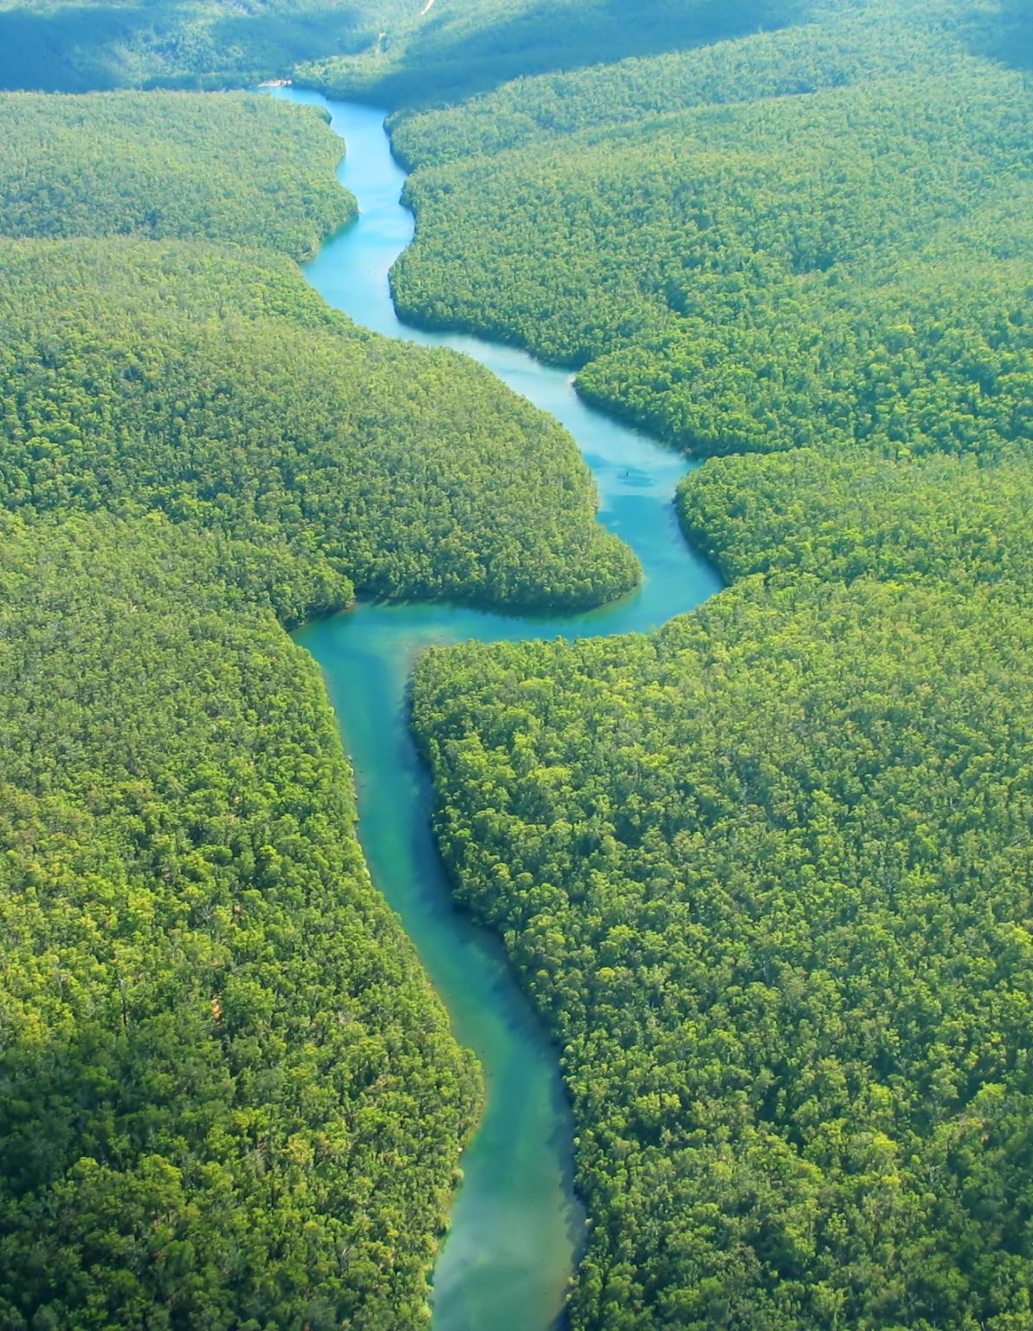
MANGROVE
A mangrove is a type of coastal ecosystem characterized by salt-tolerant trees, shrubs, and plants that thrive in intertidal zones where freshwater meets the sea. Mangroves are found in tropical and subtropical regions around the world and are known for their unique root systems, which provide stability and enable them to survive in harsh environments with fluctuating water levels and salinity

Slide 6
Key Features of Mangroves

Slide 7
Root Systems: Prop roots, pneumatophores (aerial roots), and buttress roots help with stability, oxygen intake, and sediment trapping.
Adaptations: They have salt-filtering capabilities and special mechanisms for conserving freshwater.
Biodiversity Hotspots: Mangroves support diverse wildlife, including fish, crabs, birds, and even reptiles like crocodiles.
Ecosystem Services: They offer crucial services such as:
Coastal protection against erosion and storm surges.
Carbon sequestration, aiding in climate regulation.
Nurseries for marine life.
Water filtration and sediment stabilization.

Slide 8

How many mangroves are in world

Slide 9
The total global area of mangrove forests is approximately 14-15 million hectares (34-37 million acres). Mangroves are found in 123 countries and territories, primarily in tropical and subtropical coastal regions. The largest mangrove areas are in countries like Indonesia, Brazil, Nigeria, Australia, and Mexico.

Slide 10
What is mangrove flora?
Refers to plants life that inhabits mangrove ecosystem.

Slide 11
What are the 4 types of tress in mangroves?
1.Red mangrove (Rhizophora mangle)
2.Black mangrove (Avicennia germinans)
3.White mangrove (Laguncularia racemosa)
4.Buttonwood (Conocarpus erectus)

Slide 12
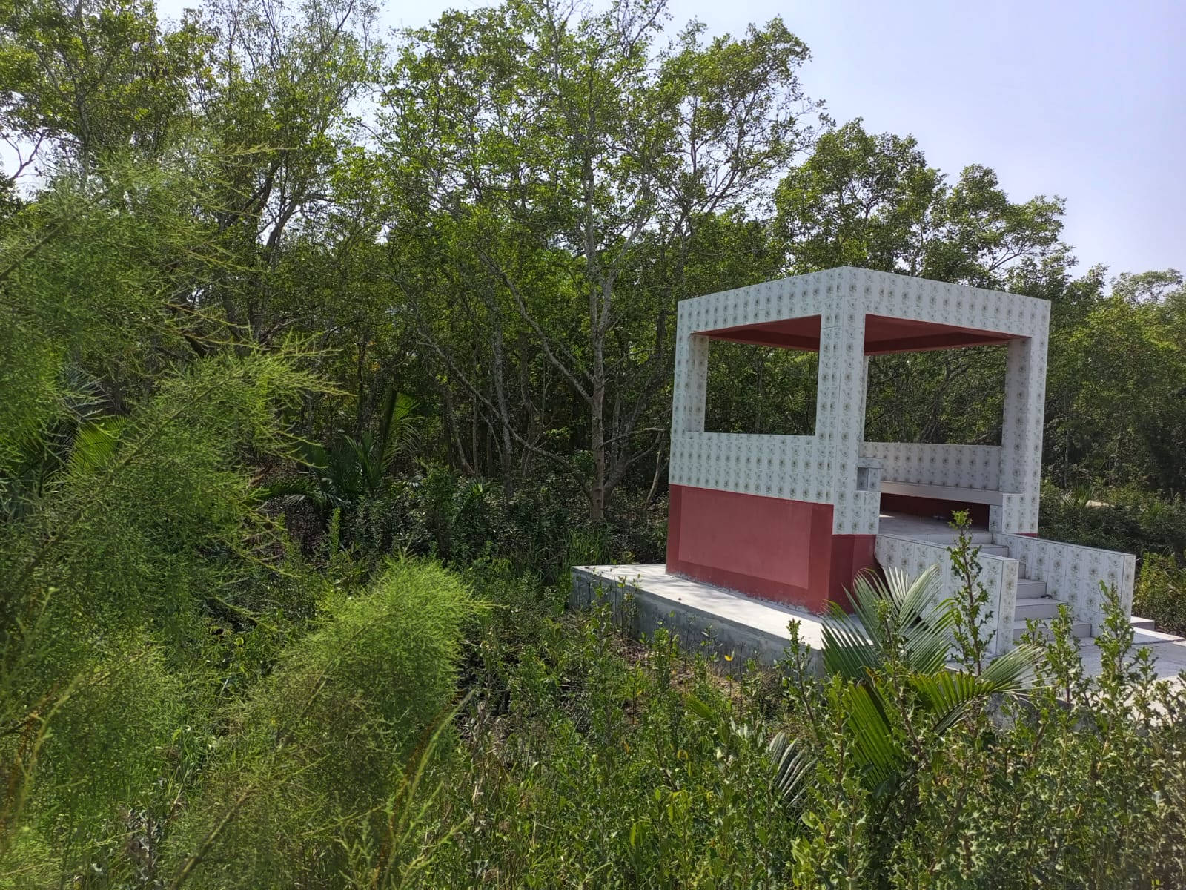
Sundarban

Slide 13

The Sundarbans is the largest mangrove forest in the world, spanning across India and Bangladesh. It covers approximately 10,000 square kilometers (3,900 square miles), with about 60% in Bangladesh and 40% in India.

Slide 14

Mangrove flora in Sundarban
Sundarban is the largest delta formed by the confluence of the Ganges, Brahmaputra and Meghna rivers in the Bay of Bengal
More than 300 species of plants found.
Sundari (Heritiera fomes)
Genwa (Excoecaria agallocha)
Hargoja (Acanthus ilicifolius)
GolPata (Nypa fruiticans)

Slide 15
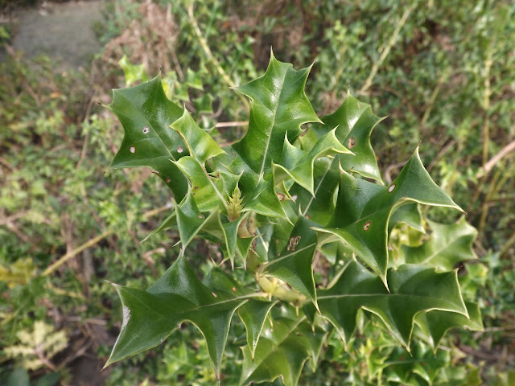
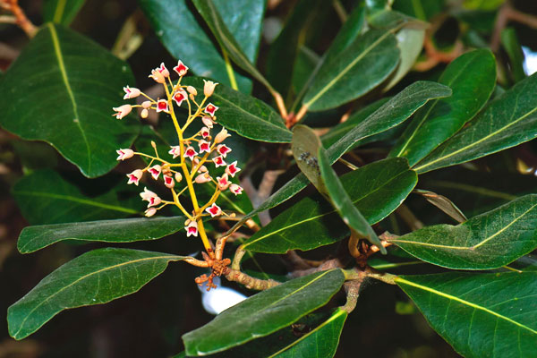
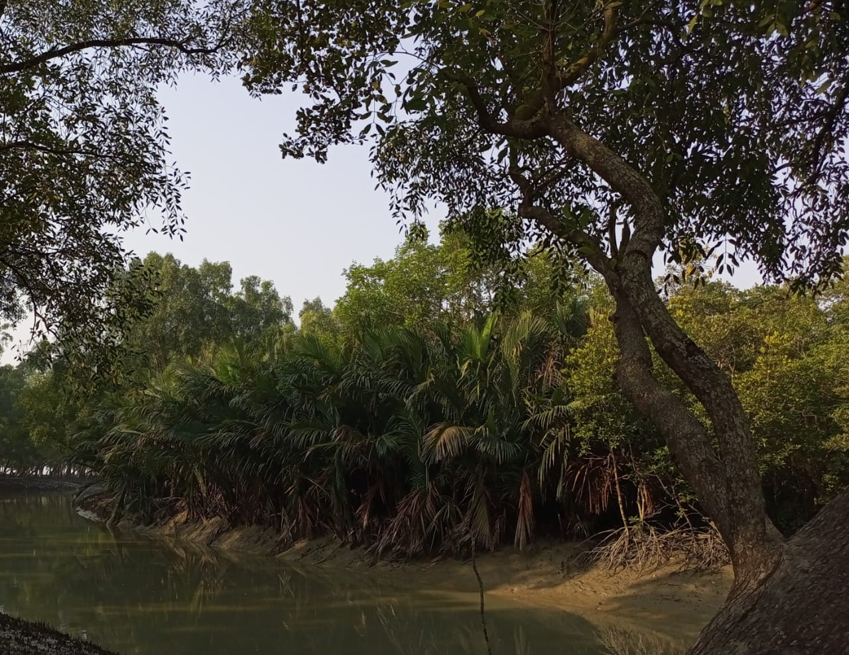
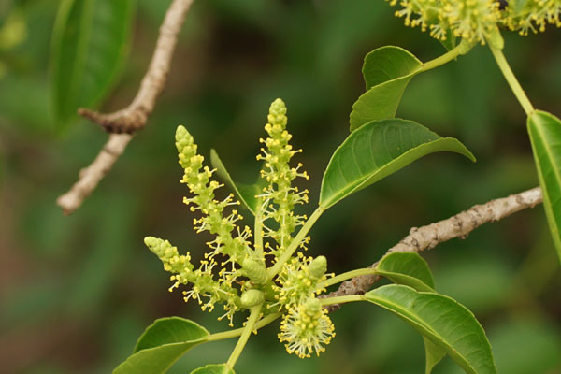
Mangrove flora in Sundarban
Sundari (Heritiera fomes)
Genwa (Excoecaria agallocha)
Hargoja (Acanthus ilicifolius)
GolPata (Nypa fruiticans)

Slide 16
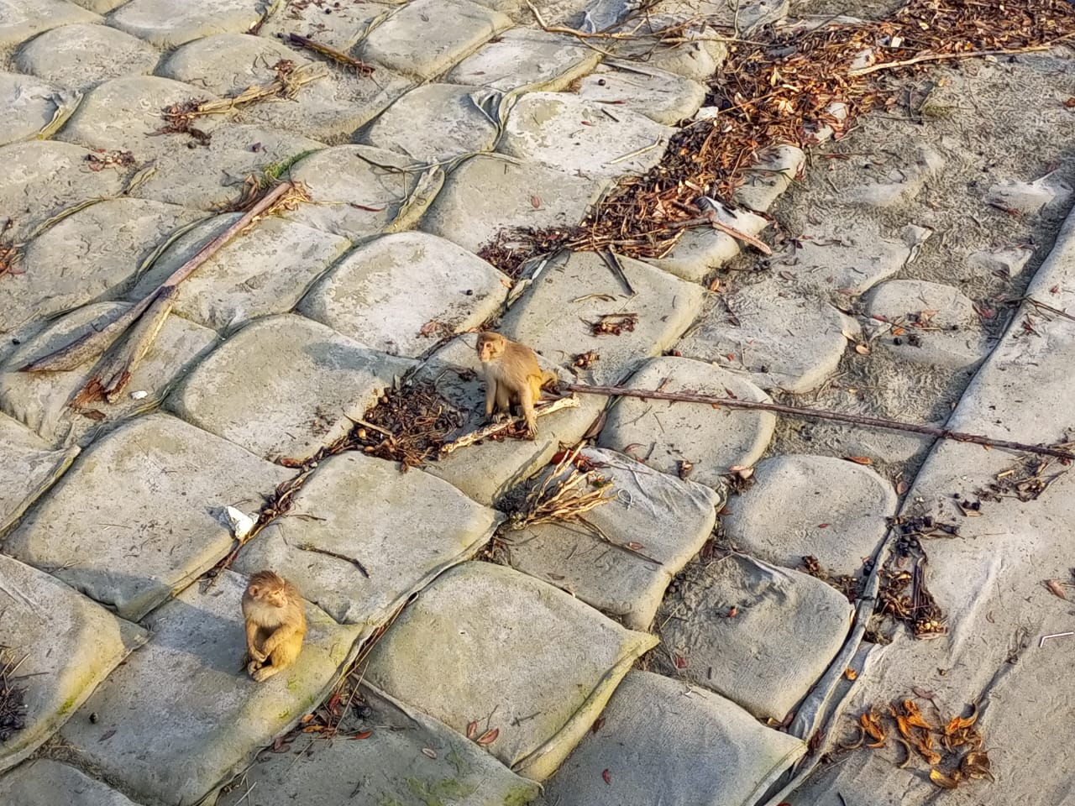
What is mangrove fauna?
Refers to the animal inhabitats including fish, crustaceans, birds, reptailes, mammals, invertebrates, amphipians.

Slide 17
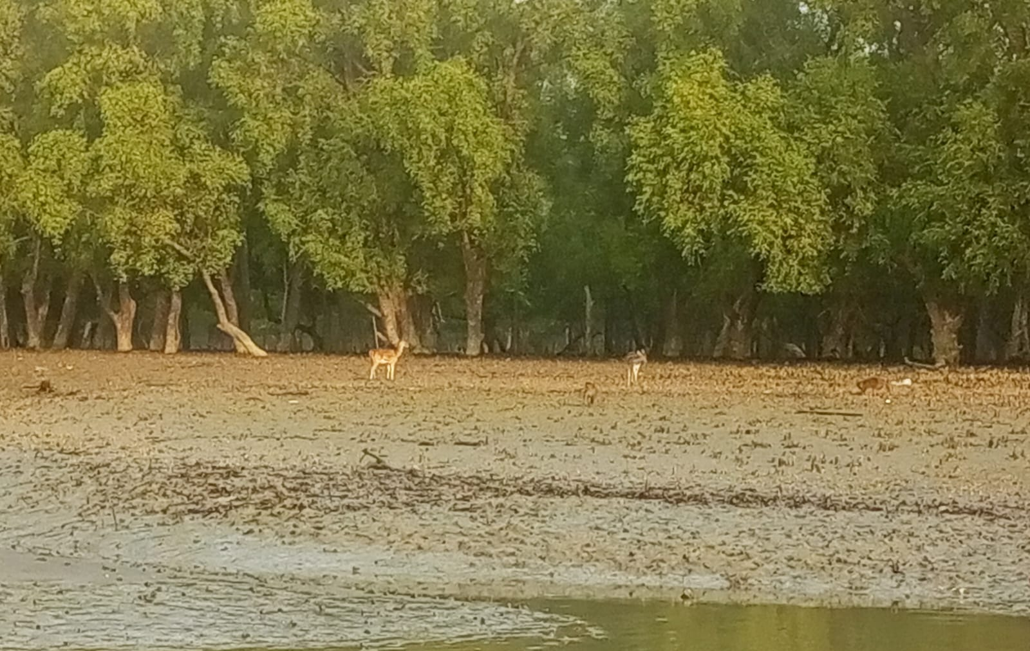
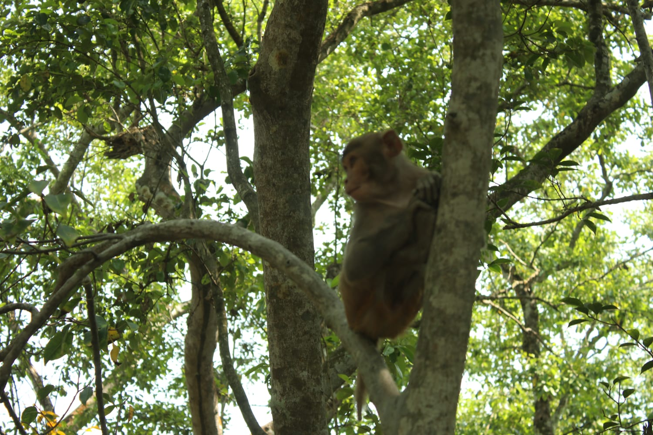
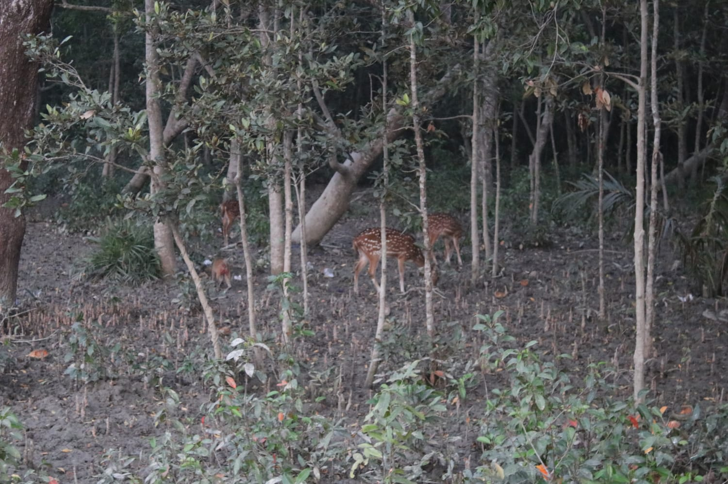
Mangrove Fauna in Sundarban

Slide 18
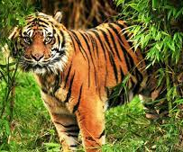
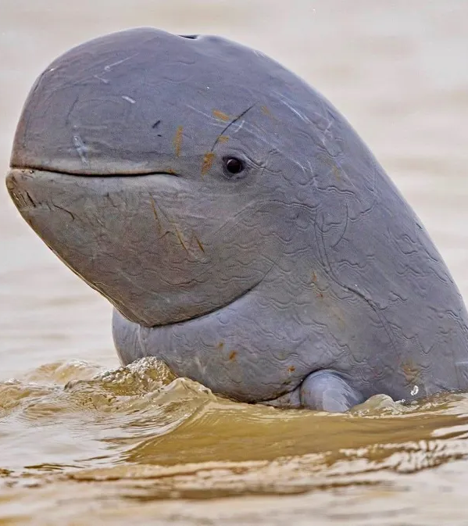
Royal Bengal Tiger & Irrawadi Dolphine

Slide 19
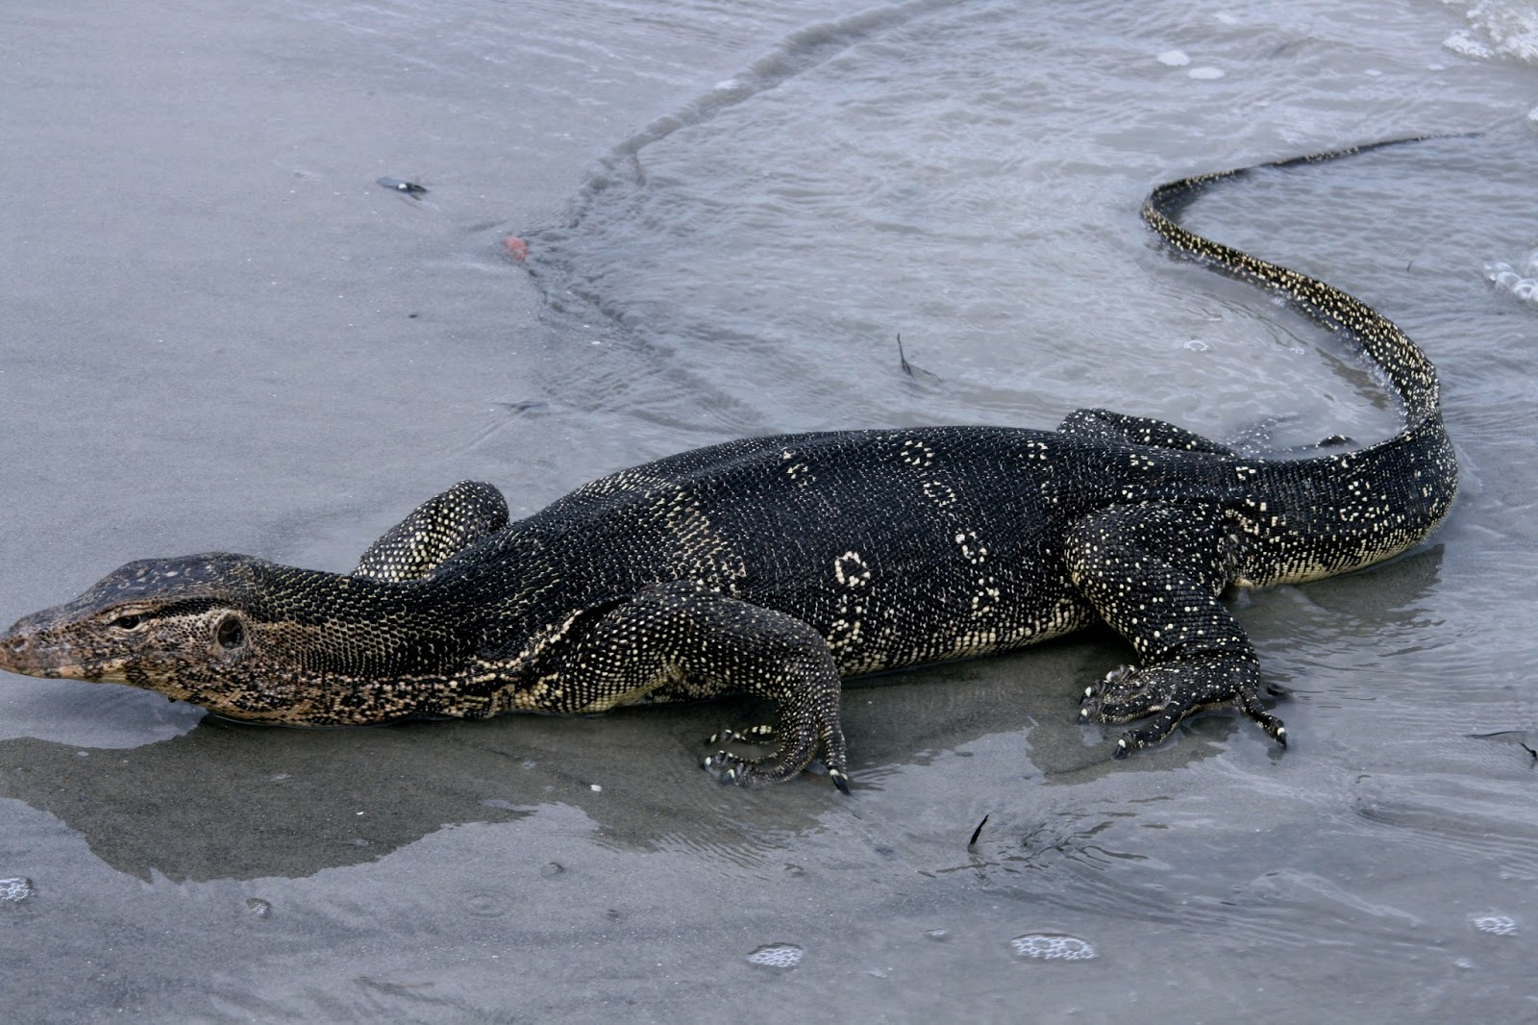
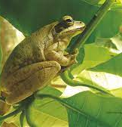
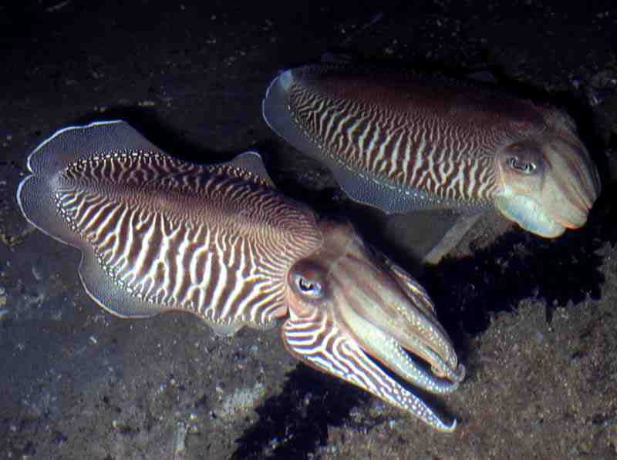
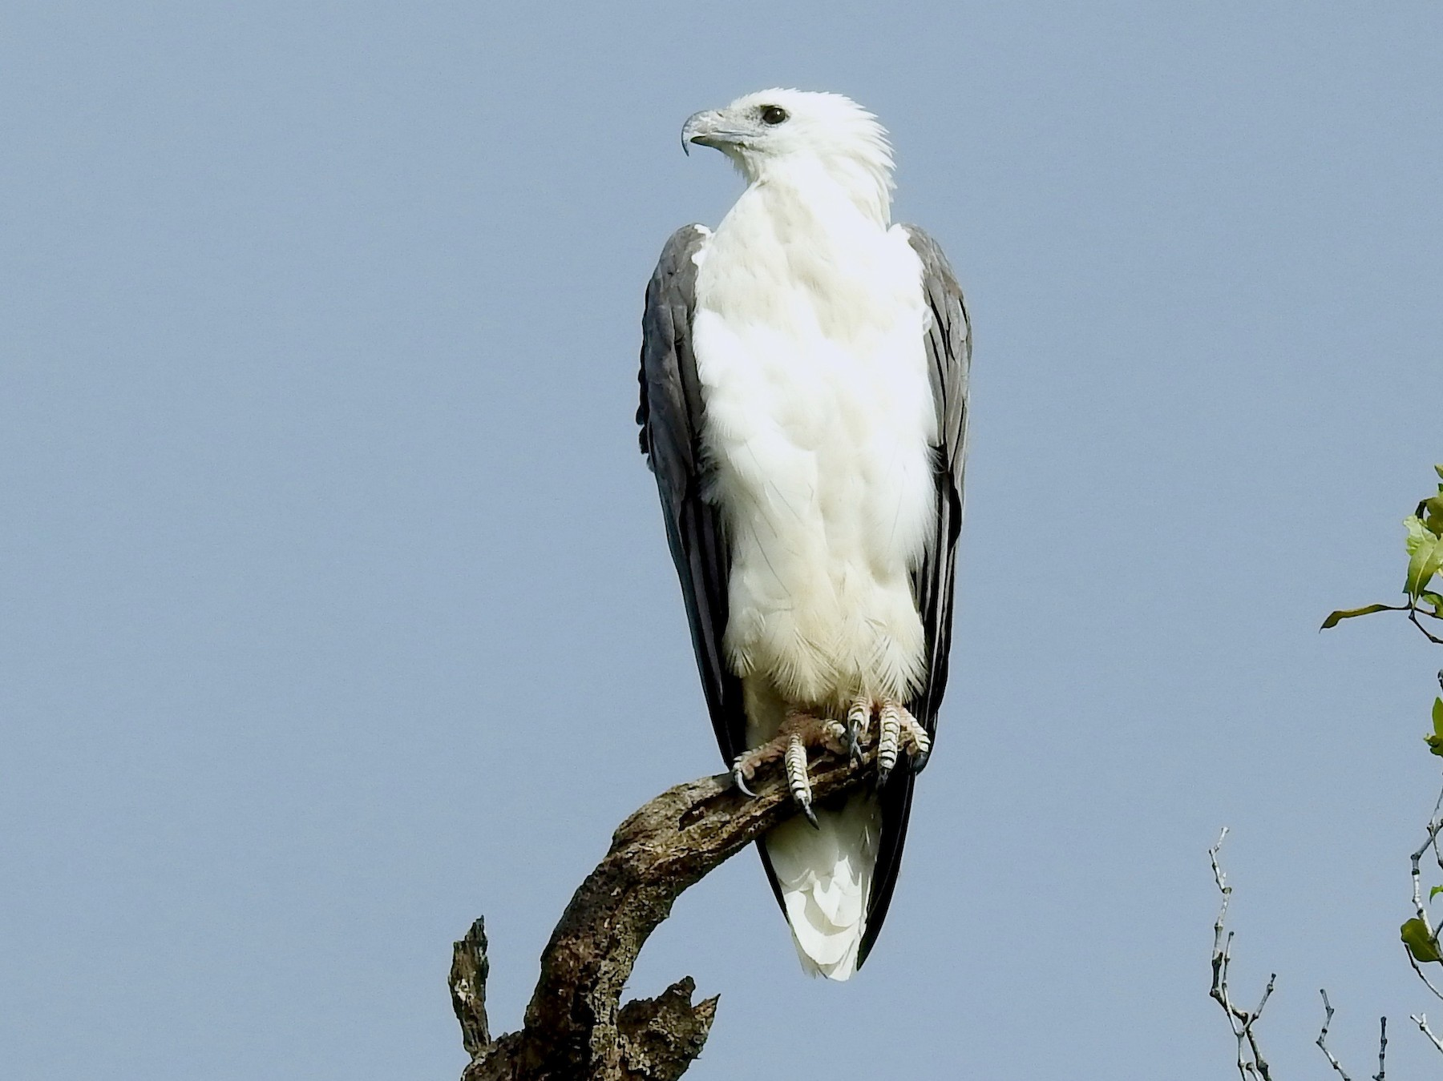
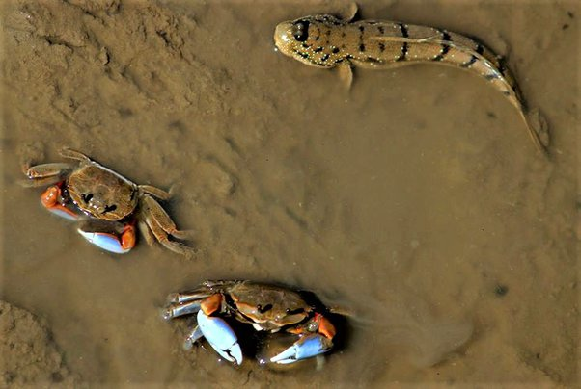
White Bellied Sea Eagle Green Frog, Monitor Lizard, Mud Crab, Sepia officinalies

Slide 20
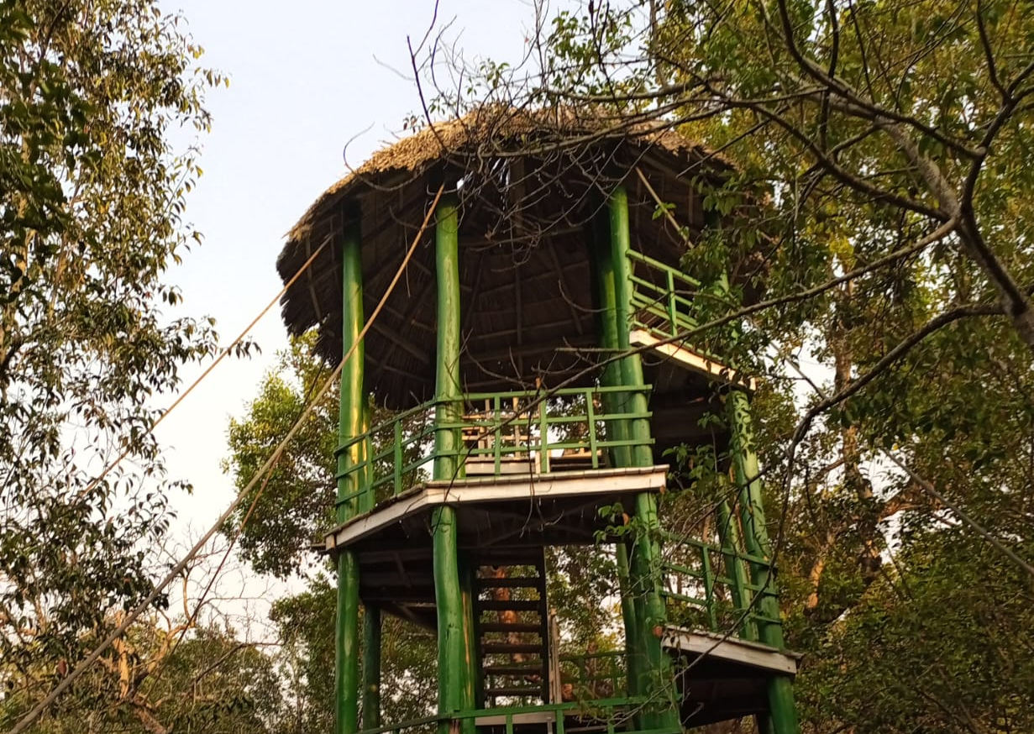
Threats for Mangrove ecosystem
Climate change
Human-wildlife conflict
Over-exploitation of resources
Pollution
Habitat loss
Lack of awareness

Slide 21

Threats of Sundarban

Slide 22

Deforestation: Mangroves are often cleared for agriculture, aquaculture (especially shrimp farming), and urban development.
Coastal Development: Expansion of ports, resorts, and urban areas leads to habitat destruction.
Pollution: Industrial waste, oil spills, and agricultural runoff degrade mangrove habitats.

Slide 23
Sea-Level Rise: Rising sea levels can submerge mangrove forests, especially where they can't move inland due to human-made barriers.
Storms and Cyclones: Increasing frequency and intensity of tropical storms can damage mangrove forests.
Temperature Changes: Altered temperatures may impact species composition and reduce mangrove health.

Slide 24

Conservation Efforts

Slide 25
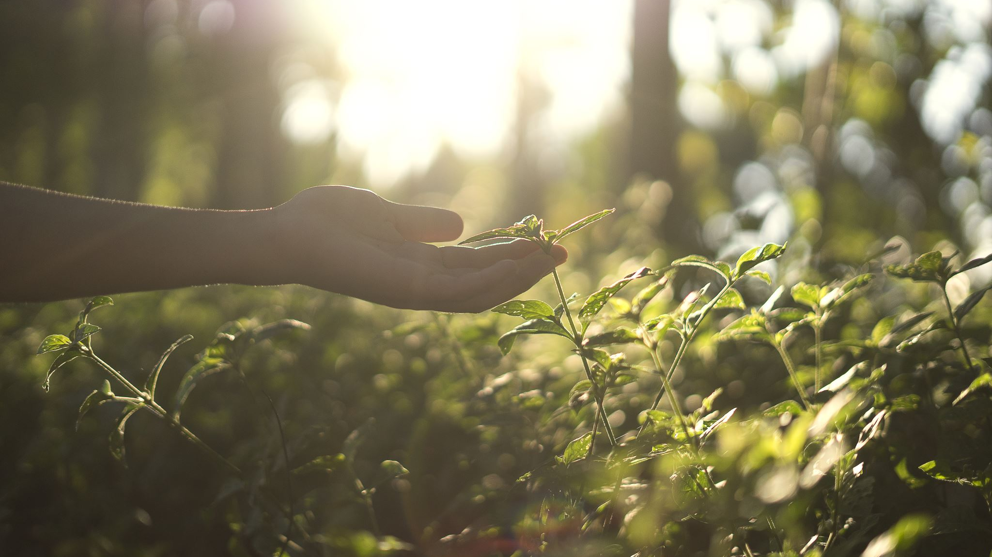
Efforts to protect mangroves include establishing protected areas, reforestation projects, and creating international agreements like the Ramsar Convention on Wetlands. Public awareness and community participation are crucial for long-term conservation

Slide 26
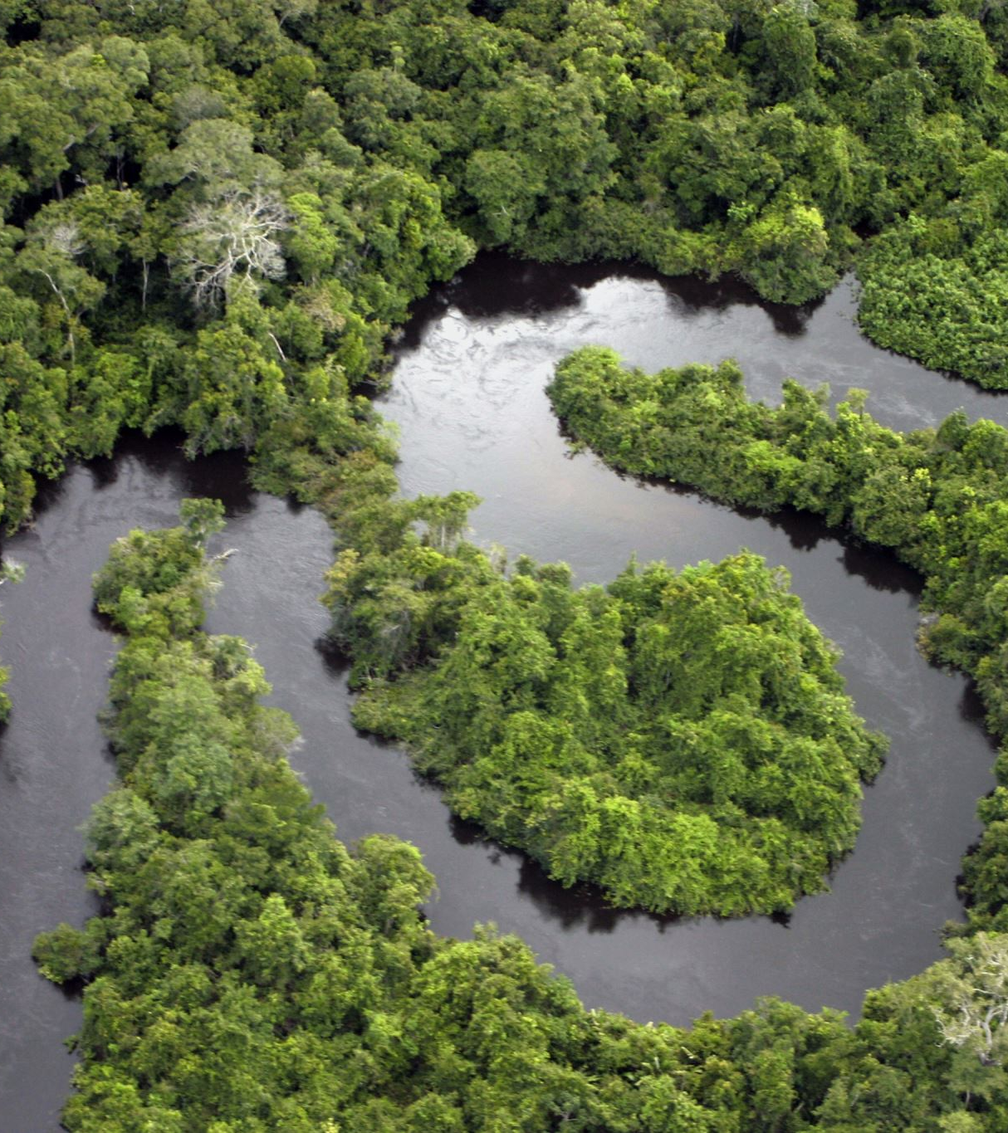
Sundarban as World Heritage
The Sundarbans was designated a UNESCO World Heritage Site due to its unique biodiversity, ecological importance, and cultural significance. The recognition came in two parts:
Sundarbans (Bangladesh): Inscribed in 1997.
Sundarbans National Park (India): Inscribed in 1987.

Slide 27
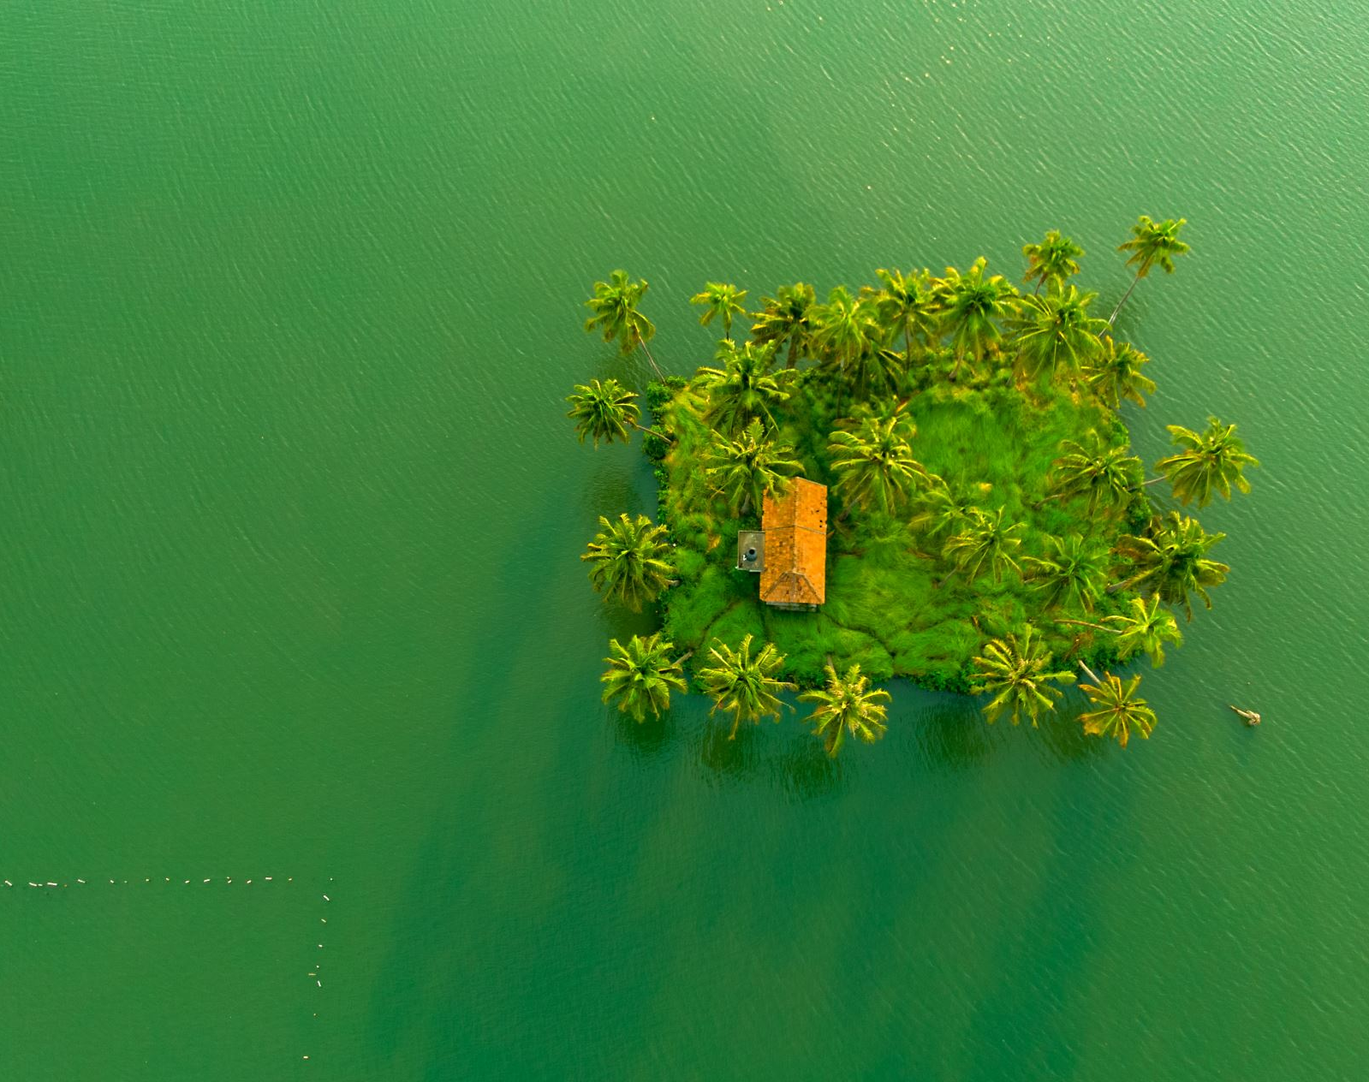
Why the Sundarbans is a World Heritage Site

Slide 28
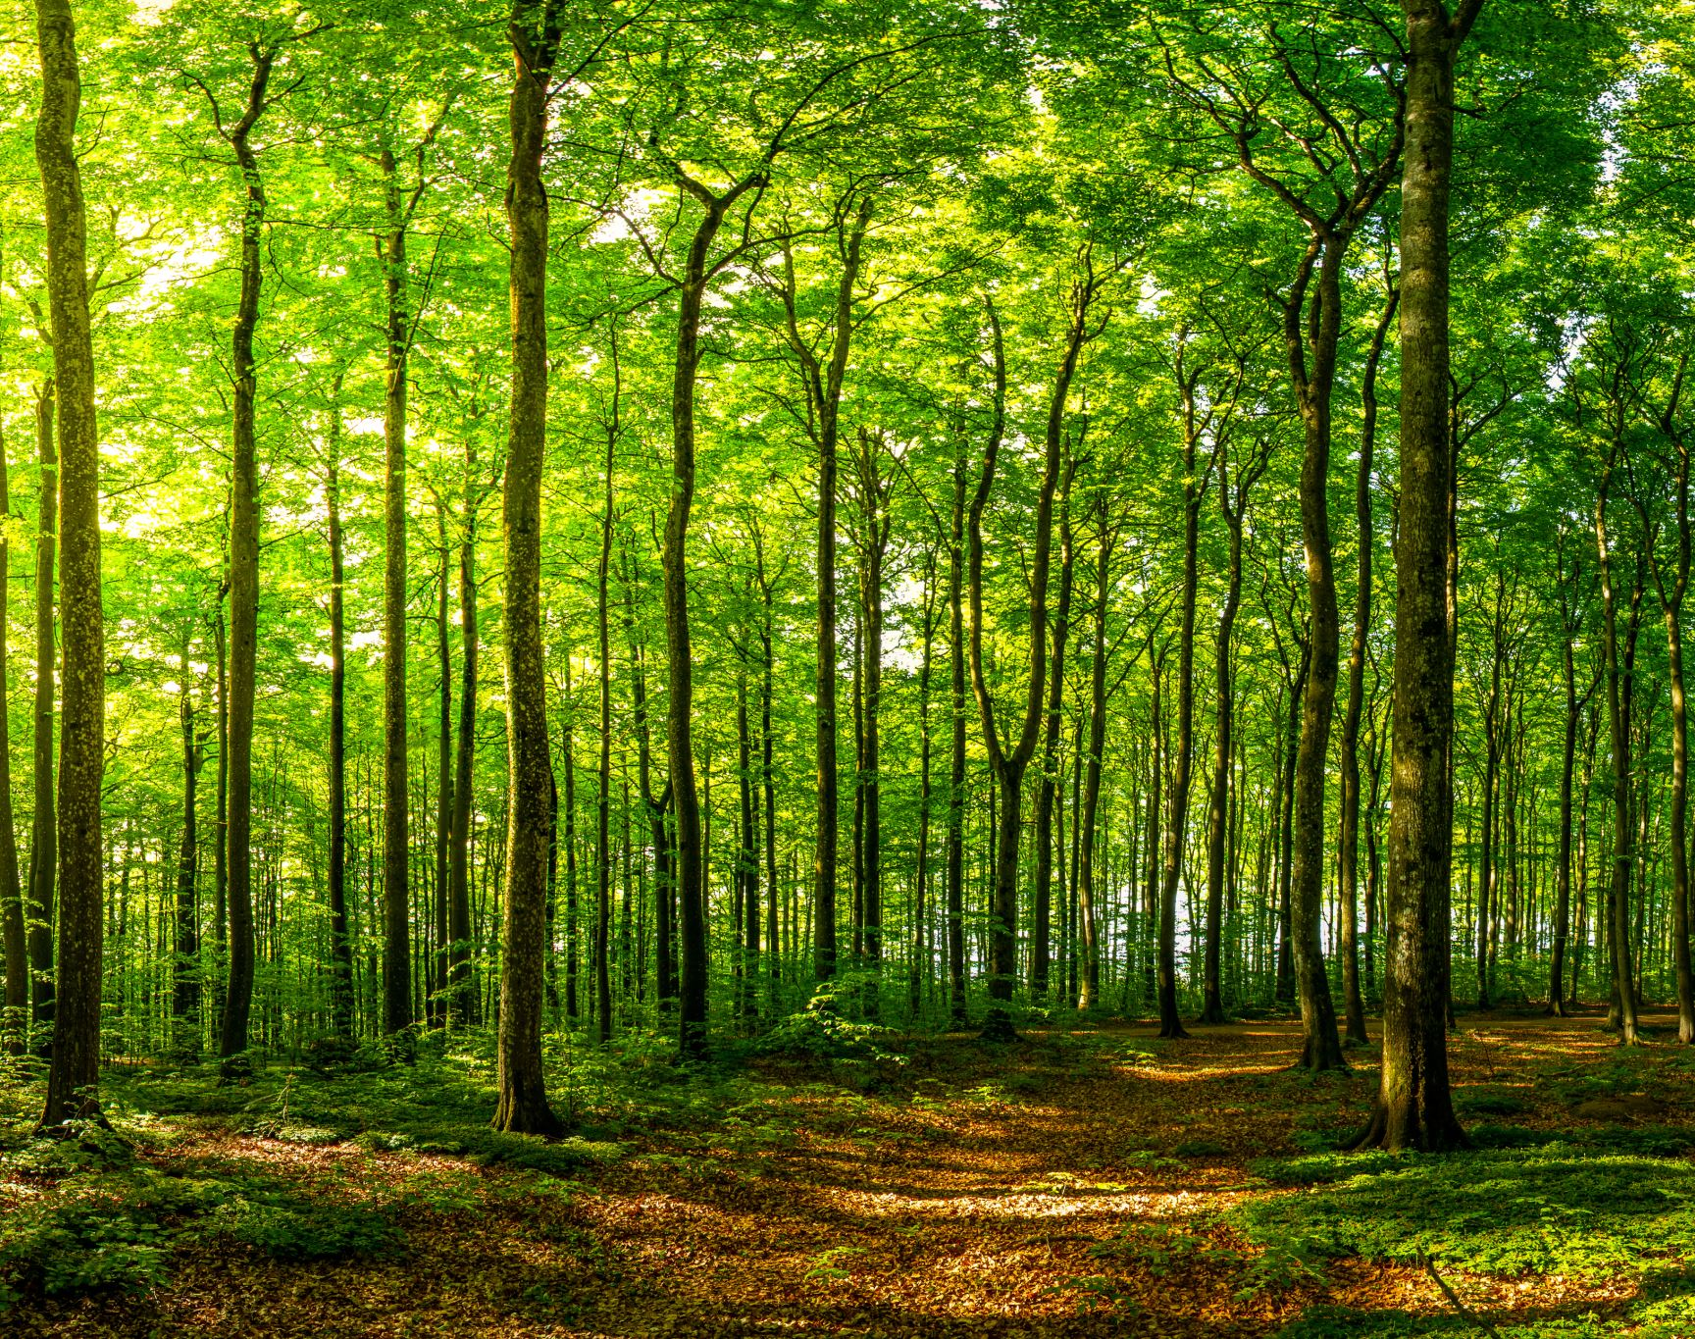
Biodiversity Hotspot Largest Mangrove Forest Ecological Importance Cultural and Historical Value

Slide 29
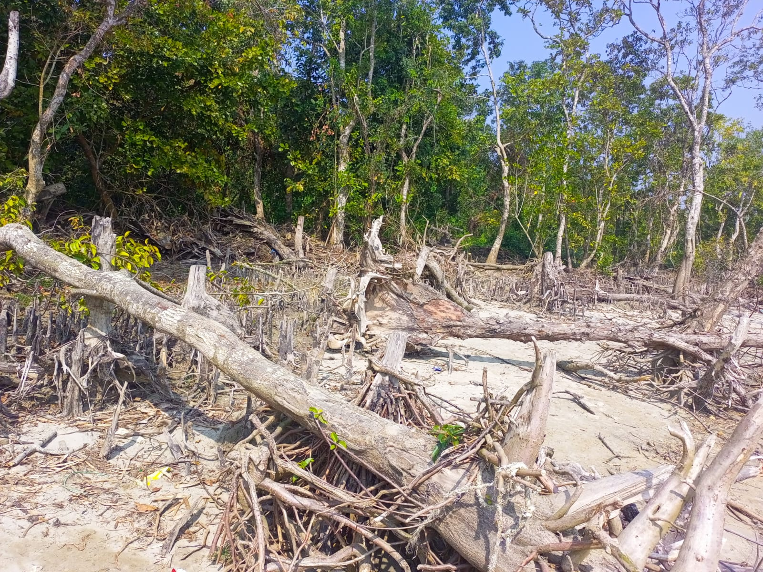

Slide 30
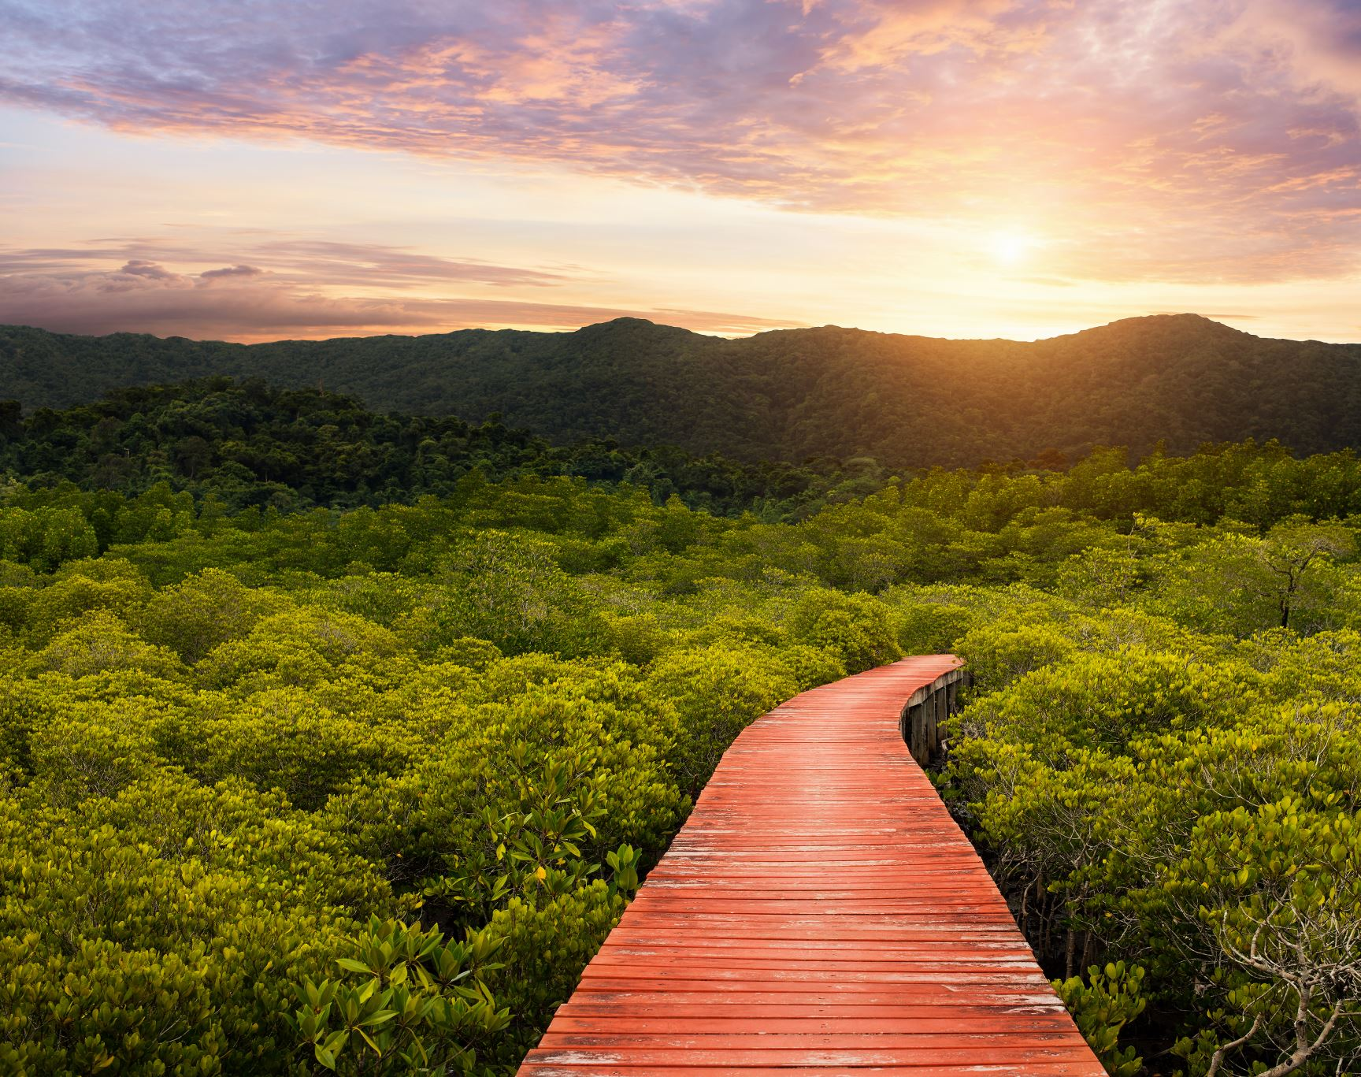
THANK YOU MANGROVE

